Slide 1

1
Notes:
These slides are designed to be used as a supplement to the lessons for Exploring the Science of Retroreflectivity.

Slide 2
ENGAGE
2

Slide 3
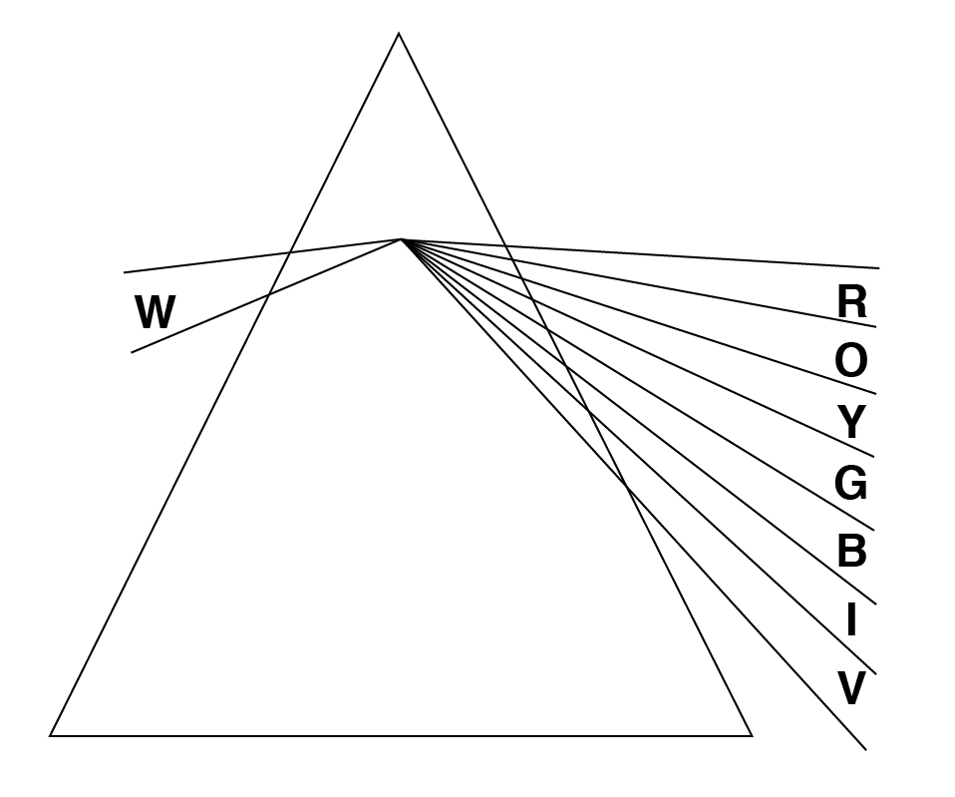
ENGAGE
TEACHER DEMONSTRATION: A RAINBOW OF LIGHT
Notes:
Sunlight or white light enters the prism and is separated into its various wavelengths: Red has the longest wavelength at the top and violet has the shortest wavelength at the bottom. You should see the break in the colors!

Slide 4

STUDENT ACTIVITY: RAINBOW GLASSES
EACH OF YOU WILL BE GIVEN YOUR OWN RAINBOW GLASSES TO USE
AND KEEP.
HERE ARE YOUR INSTRUCTIONS:
1) PUT ON GLASSES, WALK AROUND THE ROOM LOOKING AT VARIOUS LIGHTS, AND DESCRIBE TO YOUR TEAM WHAT YOU SEE.
2) PICK YOUR FAVORITE VIEW OF LIGHTS AND STOP TO ILLUSTRATE, COLOR, AND DESCRIBE WHAT YOU SEE ON YOUR LAB SHEET.
WHILE YOU MAY SEE SOME SUNLIGHT COMING INTO THE CLASSROOM:
DO NOT LOOK DIRECTLY AT THE SUN - EVEN WITH YOUR GLASSES ON!!
Notes:
Students will view various lights through the diffusion “rainbow” glasses. Have them pick the view they enjoy the most to describe and illustrate on the lab sheet.

Slide 5
CLASS DISCUSSION QUESTIONS
ENGAGE
For each of the objects below, answer the following questions:
1. Which color, or colors, are reflected?
2. Which color, or colors, are absorbed?
3. How do you know?
Notes:
Smiley Face: Yellow is reflected, leaving R,O,G,B,I,V absorbed. Heart: Red is reflected. O,Y,G,B,I,V is absorbed. Star: Lime Green means that both green and yellow are being reflected together and R,O,B,I,V are absorbed. The Moon: Dark grey (like the real moon) means that all colors are absorbed, but a small percentage is reflected as well giving us, not black, but close. Our actual moon absorbs on average 88% of the light from the sun and only 12% reflects off the moon and that is the light we see from Earth.

Slide 6
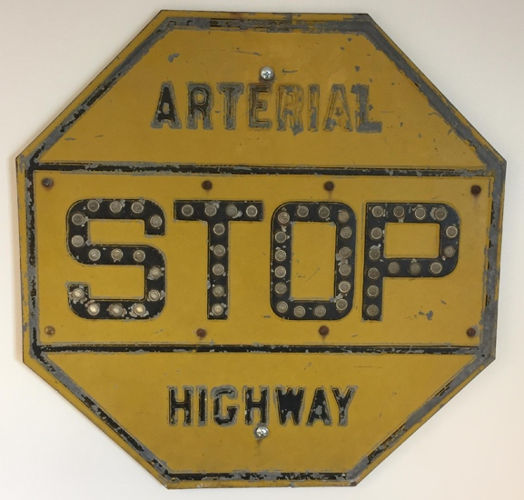
FUN FACTS IN TRANSPORTATION
ENGAGE
The first STOP sign was used in Detroit, Michigan in 1915.
The STOP sign evolved through many forms before coming
to the white and red octagon we see everywhere today.
Early STOP signs had a yellow
background with black letters.
However, yellow was also the
color used for warning signs
and engineers wanted drivers
to be able to quickly tell the
difference between STOP and
warning signs.

Slide 7

FUN FACTS IN TRANSPORTATION
ENGAGE
Around the same time,
red became the color
used in traffic signals to
indicate stop.
In order to unify traffic signals
and STOP signs, a red
background with white letters
was chosen for STOP signs.
It was not until 1954 that the federal government worked to standardize sign shape and color across the country.

Slide 8


FUN FACTS IN TRANSPORTATION
ENGAGE
What most stands out on these early signs?
Do you notice words or background colors first?
Why do you think you see them this way?
Notes:
What stands out about these early signs? Contrasting color between word and sign and also bright sign or bright words.
Do you notice words or background color first? This might be answered differently from one kid to another, but generally, the bright yellow of the first sign and the bright wording on the second sign first catch your attention.
Why do you think you see them this way? The lighter, brighter color tends to capture our eyes first.

Slide 9
EXPLORE
9

Slide 10
EXPLORE
STUDENT ACTIVITY: ANGLE OF REFLECTION
BEFORE WE START! SAFETY REMINDER!
DO NOT AIM YOUR LASER POINTER AT ANYONE.
ALWAYS HAVE A PATH THROUGH EACH MEDIUM AND A TARGET.
DO NOT LOOK DIRECTLY AT THE LASER POINTERS.
AIM FOR THE CENTER OF THE MIRROR
Notes:
Help the students understand that they will shine the laser along the lines indicated above for each angle (20, 50 and 80 degrees). They will use the inner angle for the laser they shine and the outer measurement for the laser beam reflected as noted above.

Slide 11
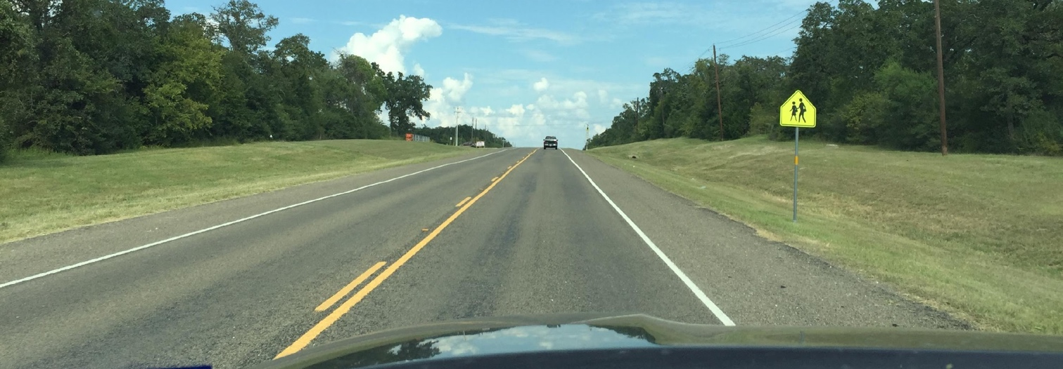
CLASS DISCUSSION QUESTIONS
EXPLORE
We can see the sign ahead because it is daytime. In rural areas, signs are placed 12 feet to the right of the road.
At night, when a vehicle’s headlights shine on a sign to the right of the road, according to the angle of reflection where should the light end up going?
Where does the light need to go for drivers to be able to see and read the sign at night? Why?
Notes:
At night, when a vehicle’s headlights shine on a sign to the right of the road (click to show arrow going from headlight to sign), according to the angle of reflection where should the light end up going? (After some discussion, click to show arrow leaving sign). As we approach the sign the reflected light would travel away from the sign at the same angle our headlights struck the surface. This makes the sign difficult for the driver to see at night.
Where does the light need to go for driver to be able to see and read the sign at night? Why? Back toward the drier. This is why sign material is engineered to “retroreflect,” or send light back in the direction of the vehicles.

Slide 12

EXPLORE
STUDENT ACTIVITY: DIFFUSION
BEFORE WE START! SAFETY REMINDER!
DO NOT AIM YOUR LASER POINTER AT ANYONE.
ALWAYS HAVE A PATH THROUGH EACH MEDIUM AND A TARGET.
DO NOT LOOK DIRECTLY AT THE LASER POINTERS.
Draw arrows to show the various directions of travel.
Color everywhere you see the laser light in or around the plastic.
Notes:
The students will use a color to indicate where the light transmits and stays, and draw arrows to show where it goes if it leaves the plastic. Be sure to also have them look up at their hands to see if any light is being reflected.

Slide 13
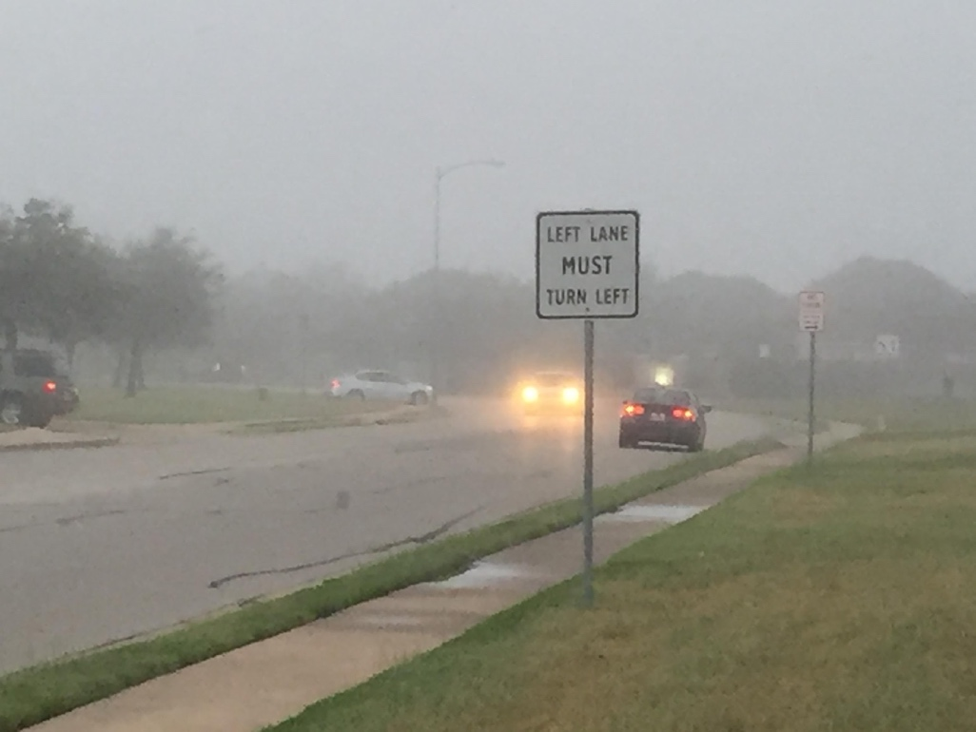
CLASS DISCUSSION QUESTIONS
EXPLORE
EXPLORE
Why would you use your low beam (dim) headlights in fog
rather than your high beam (bright) headlights?
Notes:
This activity should help students understand diffusion of light. When light is diffused it scatters.
Why would you use your low beam (dim) headlights in fog rather than your high beam (bright) headlights? This activity should help students understand diffusion of light. When light is diffused it scatters. The bright headlights will provide more light for the fog to scatter, making it too difficult for the driver to see the road. The dim headlights provide less light and shine slightly down, under the fog, making the markings on the road more visible.

Slide 14
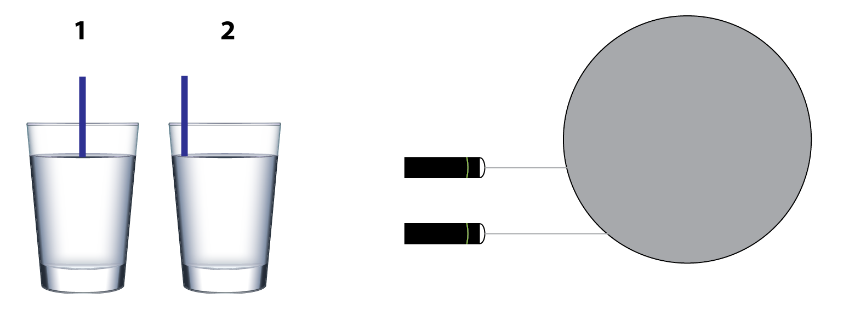
EXPLORE
EXPLORE
STUDENT ACTIVITY: REFRACTION
BEFORE WE START! SAFETY REMINDER!
DO NOT AIM YOUR LASER POINTER AT ANYONE.
ALWAYS HAVE A PATH THROUGH EACH MEDIUM AND A TARGET.
DO NOT LOOK DIRECTLY AT THE LASER POINTERS.
1
2
1
WALL OR WHITE PAPER
2
COMPLETE THE STRAW’S IMAGE, FOR EACH GLASS, BELOW THE SURFACE OF THE WATER.
COMPLETE THE LASER’S IMAGE, FOR EACH POSITION, AS IT TRAVELS THROUGH THE WATER.
Notes:
In the first part of the activity, students will place a straw in the positions shown above. They will view the water glasses from the side of the glass and illustrate and describe what they see for each position (1 and 2).
For the second part of the activity, students will shine the laser pointer through the glass at positions 1 and 2, and then draw the path through the glass and to the wall for each position and describe their findings as well on the lab sheet.

Slide 15
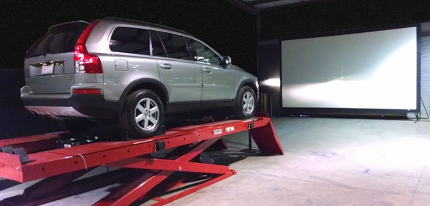
CLASS DISCUSSION QUESTION
EXPLORE
In America, low beam headlights provide a distribution of light to illuminate the roadway in front of and to the right of the driver. Why?
What about in countries where they drive on the other side of the road?
Credit: Sapphire Technical Solutions
Notes:
In America, low beam headlamps provide a distribution of light to illuminate the roadway in front of and to the right of the driver. There are limits on the amount of light that goes up and to the left. Why? Vehicle headlights in America help the driver see road signs and pavement markings, but prevent light from shining directly into the eyes of drivers in oncoming vehicles.
What about in countries where they driver on the other side of the road? In countries where they drive on the left, their headlights would need to shine more to the left.

Slide 16
EXPLAIN
16

Slide 17
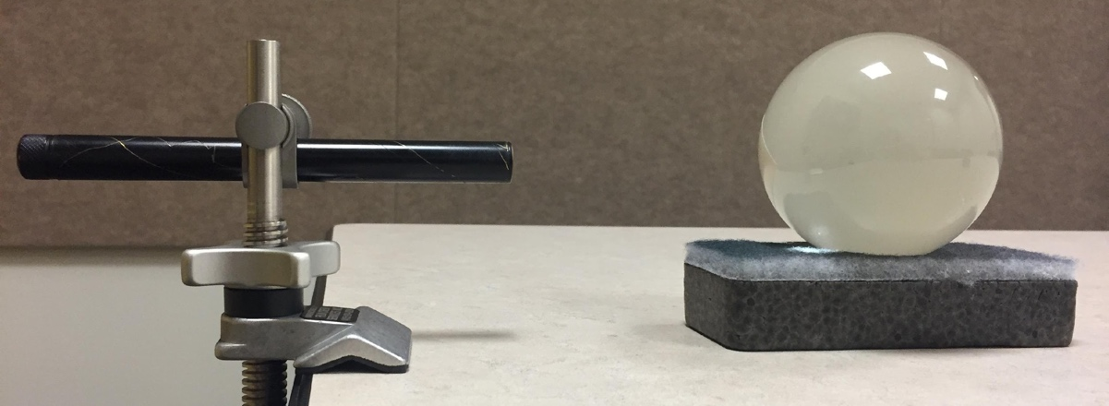
EXPLAIN
TEACHER DEMONSTRATION:
Light Through a Glass Sphere
Where does the light go? Draw arrows and color to illustrate what you see as the light from the flashlight and laser is transmitted through the glass sphere.
LIGHT FROM
TEACHER
WHITE WALL/PAPER
WHITE PAPER
LARGE GLASS SPHERE
Notes:
Have the students stand to the side of the demo. Their view should be similar to the picture shown above. Make sure the path of the laser is visible to students, but from this angle there should be little to no actual light from the laser going towards the students. However, remind them not to look directly at the laser light. They should see some light transmit into the sphere and stay or be absorbed, but most of the light should reflect back towards the teacher.
You will first shine a flashlight, then a laser pointer, than a laser pointer with a flat piece of foil wrapped around a file folder in place of the white wall near the sphere. You can also wrap some foil around the backside of the sphere for maximum retroreflection. However, do not emphasize this last effect, as students will work to figure out this method in the next lesson.

Slide 18
EXPLAIN
TEACHER DEMONSTRATION:
Retroreflection
Sign
Source
Receptor
Notes:
Here is a visual to go with the students’ individual description of retroreflection on the lab sheet.

Slide 19
EXPLAIN
STUDENT ACTIVITY: Does Color Matter?
Which colors retroreflect light the best?
Choose a clear marble and four other marbles of your choice. Place them on a light colored or white background. Holding the flashlight on your chin, shine the light directly on each marble.
Notes:
Since retroreflectivity is the light shining back towards the source, have students hold the flashlight on or just below their chin as they look at each marble.

Slide 20
EXPLAIN
CLASS DISCUSSION QUESTION
Why did we place the marbles on a white or light colored surface?
What if we placed the marbles on a dark surface? Would it change how much light they reflect?
Notes:
Have students discuss this and then allow them time to try it out and see the results. They should have additional access to black construction paper if needed for observations.
Why did we place the marbles on a white or light colored surface? The lighter color would not absorb the light from the flashlight but would instead allow it to reflect it back through the marble.
What if we placed the marbles on a dark surface? Would it change how much light they reflect? Yes, the darker surface would absorb much of the light, not allowing it to reflect back through the marble and to our eyes. This would make the marble appear much dimmer. While there is contrast, the idea here is for the kids to see that light behind and immediately surrounding the marble allows for better reflection of light. Later they may combine this concept with contrasting colors between words/symbols and the background of the sign.

Slide 21
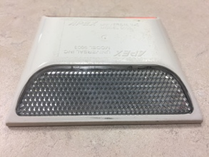
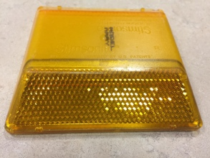
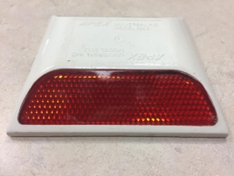
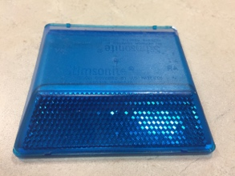
FUN FACTS IN TRANSPORTATION
EXPLAIN
Does color matter? It does when it comes to the markers along the road! See if you can guess what each color marker indicates!
WHITE
Separates traffic flow in the same direction
YELLOW
Separates traffic flow in the opposite direction
RED
Indicates you are going the wrong way
BLUE
Marks the location of fire hydrants
Notes:
This slide is animated. Click to bring up a description of what each markers means:
White – separates traffic flow in the same direction
Yellow – separates traffic flow in the opposite direction
Red – indicates you are going the wrong way
Blue – marks the location of fire hydrants

Slide 22
VIDEO RETROREFLECTIVITY
EXPLAIN
VIDEO: Retroreflective Materials: MAC RiAus PDplus
https://www.youtube.com/watch?v=rDRTmymuNyE
Notes:
VIDEO illustrating how reflection and refraction are combined to create retroreflection allowing light to return from it’s

Slide 23
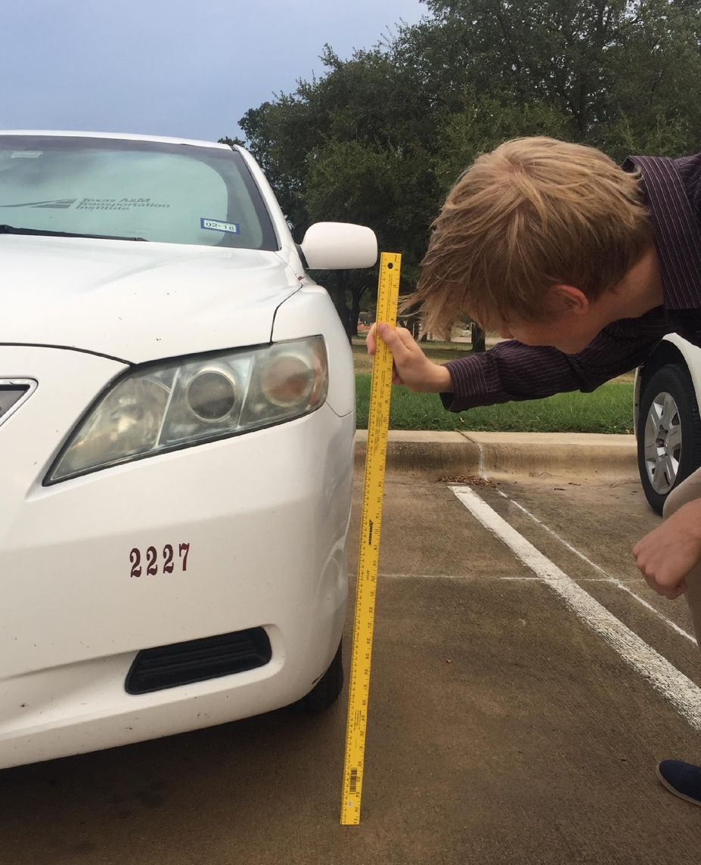
EXTENSION 1:
Measuring Headlights and Calculating Averages
EXPLAIN
Using a meterstick, gather data on 10 different vehicles from the teacher parking lot. Measure the height from the ground to the approximate center of the headlight. Be sure to measure in meters and centimeters.
Notes:
This activity is recommended for 5th grade and above students and involves data collection and analysis using averages. Students will work in pairs or small groups. Allow each group to select and measure any 10 vehicles of their choosing and calculate the average height. Share and compare averages. Reminder: Average is the sum of all data points divided by the number of data points collected.

Slide 24
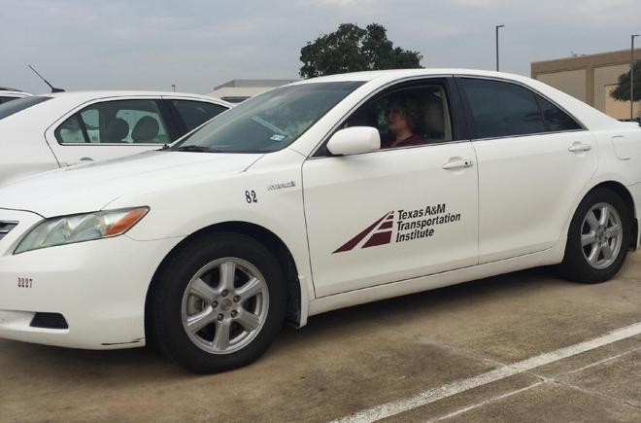
CLASS DISCUSSION QUESTIONS
EXPLAIN
What makes a good sampling of vehicles? How do you know?
Why could it be beneficial to get some measurements from many different types of vehicles?
The average driver sits 1.1 m or 110 cm above the road.
Why is this an important number
to know?
Notes:
What makes a good sampling of vehicles? How do you know? Why could it be beneficial to get some measurements from many different types of vehicles? A good sampling would include measurements from a variety of vehicles rather than the same type. Even further, the sampling should mimic the percentages of each type of vehicle on the road today.
The average driver sits 1.1 meter or 110 cm above the roadway. Why is this an important number to know? We need to know the average driver eye height so we can calculate the observation angle (angle between headlights and driver’s eyes), which impacts the ability of drivers to see traffic signs.

Slide 25
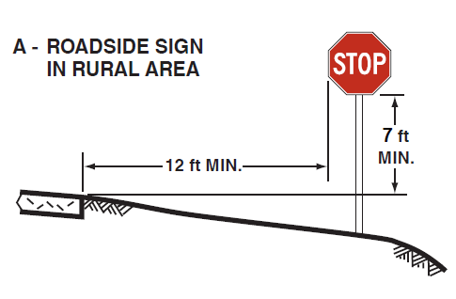
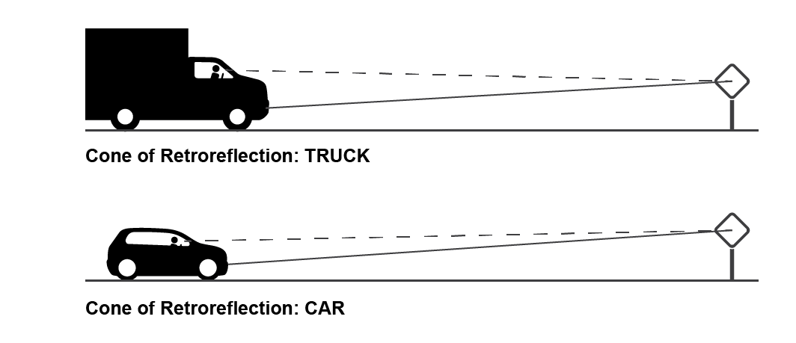
CLASS DISCUSSION QUESTIONS
EXPLAIN
In rural areas, traffic signs are typically placed 7-ft high and
12-ft to right of the edge of the travel lane. Answer the following:
What role does
retroreflection play for
the driver to see this sign?
What properties of light
do we see happening in the
retroreflection?
Which properties help
retroreflection and
which do not? Explain.
2.13 m or
213 cm
3.66 m or 366 cm
Notes:
In rural areas, traffic signs are typically placed 7-ft high and 12-ft to right of the edge of the travel lane. To see the sign, retroreflection must take place. Retroreflection is possible with the emission and transmission of the light to the sign followed by refraction, reflection, diffusion and even some absorption around the lettering. The truck needs slightly more diffusion so that the angle of observation is great enough that the light shines up and to the driver. The sign will not work with reflection alone which is where glass beads come in. We do not need absorption in the lettering or transmission through the sign for retroreflection.

Slide 26
ELABORATE
26

Slide 27
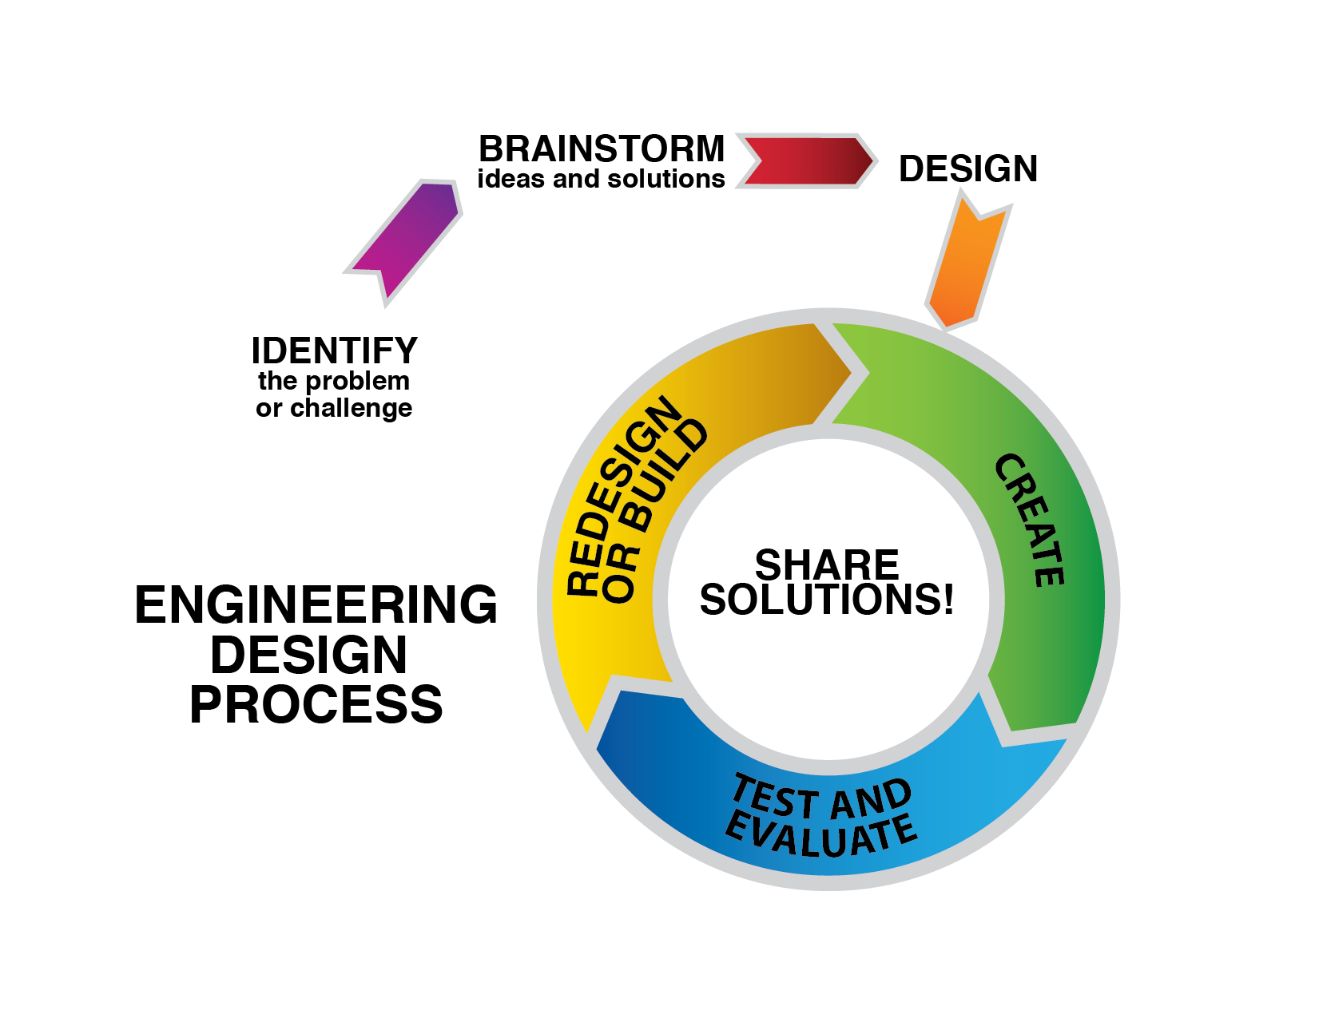
THE ENGINEERING DESIGN PROCESS
ELABORATE
Notes:
Share the model with the students so that they can get familiar with the process. The engineering design process is an ongoing cycle. It is important to note that projects can begin at many different places. It can start with an original problem or challenge or on a test of something already created. It can begin again on redesigns and new builds and an important factor is sharing solutions, and failures, along the way. Much can be learned from each of these through analysis and open minded thinking!

Slide 28

ELABORATE
STUDENT ACTIVITY:
Engineering Design Process Challenge
DEFINE THE PROBLEM (Team):
What is it that you are trying to accomplish?
ONCE YOU HAVE DEFINED THE PROBLEM TOGETHER,
BREAK OFF AND WORK AS INDIVIDUALS ON THE NEXT TWO STEPS!
BRAINSTORM (Individual):
All ideas are a good idea at this stage.
Here is where creativity is needed and
no reasonable idea is wrong or bad.
Notes:
DEFINE THE PROBLEM: What is it that you are trying to accomplish? On this challenge, we hope to achieve maximum retroreflection on a sign so that it is easily visible to drivers at night.
Break the teams up allowing each individual a place to work independently for the next two steps. This allows each member to bring back unique ideas
BRAINSTORM: Remind students to be creative here and not to discard any reasonable idea at this point. This part of the process helps us use what we know and combine it with imagination.

Slide 29
ELABORATE
ELABORATE
STUDENT ACTIVITY:
Engineering Design Process Challenge
My unique ideas to share with the group!
DESIGN (Individual):
Now it is time to work through all of the
pros and cons of each of your ideas.
Here you will take into account the criteria, constraints and materials you have available. Keep in mind the objective, what you are specifically trying to accomplish. At this point you will put your design to paper with attention to each detail. Does it meet the proper criteria for success? Does it use only materials that are available?
Notes:
INDIVIDUAL DESIGN: Here students will design their own sign. Make sure that they label every aspect so that their share out with the group will be detailed and include all of their unique ideas.

Slide 30
ELABORATE
STUDENT ACTIVITY:
Engineering Design Process Challenge
INDIVIDUALS SHARE IDEAS WITH THEIR TEAMS:
Now it is time to share each of your ideas with your team.
Analyze the best ideas each team member’s design demonstrates towards meeting your objective.
Raise questions or concerns about models that may hinder accomplishing the objective or that are outside of the constraints.
ALWAYS BE POSITIVE AND RESPECTFUL WHEN ANALYZING OTHERS WORK!
Notes:
INDIVIDUAL SHARE: Remind students that it is important to treat each individuals with respect. While not everyone’s idea will make it into the final design, each individual design will have a positive aspect that the group can commend. Concerns should be relevant to the objective and constraints and based on prior knowledge.

Slide 31
ELABORATE
ELABORATE
STUDENT ACTIVITY:
Engineering Design Process Challenge
TEAM DESIGN:
Now it is time to put your individual ideas together to complete your team design!
While not everyone’s ideas may be in the final design, each individual sign does help in the creative process and towards the team objective!
CREATE YOUR SIGN:
Make sure you list all the materials you use for this design and use ONLY materials from the list.
Notes:
TEAM DESIGN: Remind students that it is important to treat each individuals with respect. Special note: You may offer additional points or devise a payment system for supplies. Make sure that all teams have access to equal amounts of each of the materials.
CREATING THE SIGNS: Make sure that all teams have equal access to supplies. You may want to put prices on different items or reward students who return unused items to the supply inventory. You may need to remind students that they cannot write letters, pictures or words on their sign. They will need to cut out letters from the material available if needed.

Slide 32
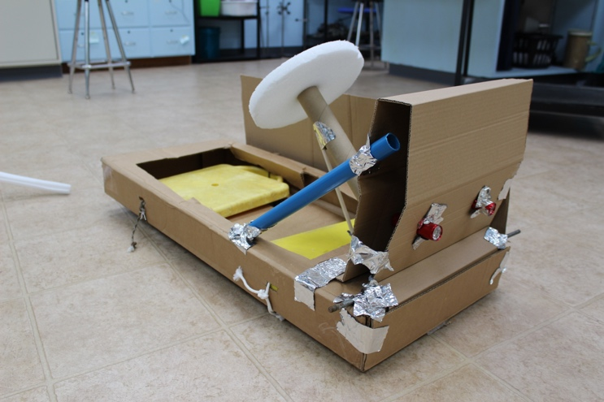
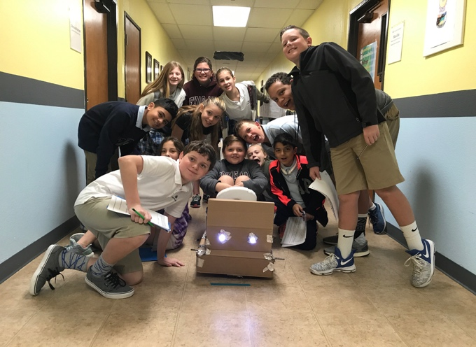
EXTENSION 2: BUILDING BETTER MODELS!
ELABORATE
BUILDING A TEST CAR
Using recycled materials or items found around the classroom, create a car to test the retroreflectivity of each team sign.

Slide 33
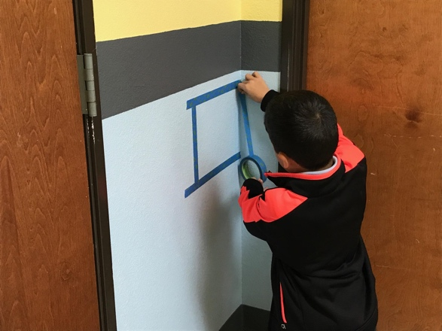
EXTENSION 2: BUILDING BETTER MODELS!
ELABORATE
MATCHING THE SIGN TO THE TEST CAR
As a class, you will need to figure out where to hang your signs in order to test them with your car.
Remember our previous numbers: 7-foot (213 cm) high sign off to the right with our headlight average of _____ cm.
Height of headlights on test car
Average height of headlights in parking lot
=
Height that you will hang the signs to test (X)
213cm (7ft)
Notes:
Here you will use the data collected from Extension 1. You will multiply the class average headlight height from the teacher’s parking lot (in cm) by X (height from the ground to the bottom of the test sign). You will then multiply the height of the headlights of the test car (in cm) by 213 cm (height of sign on a roadway). Divide that number by the class average headlight height (in cm) and you will find the height from the ground to the bottom of the test sign (in cm).

Slide 34
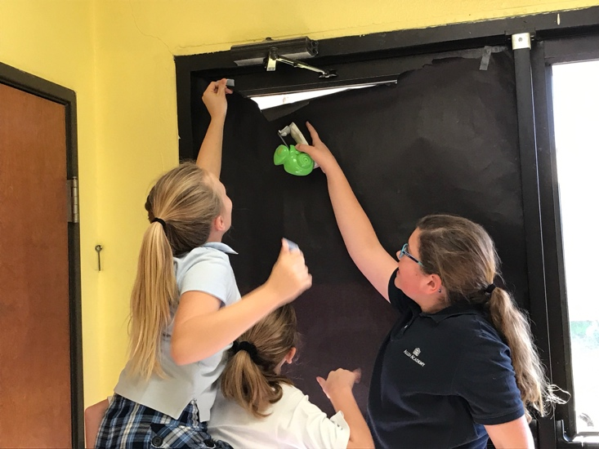
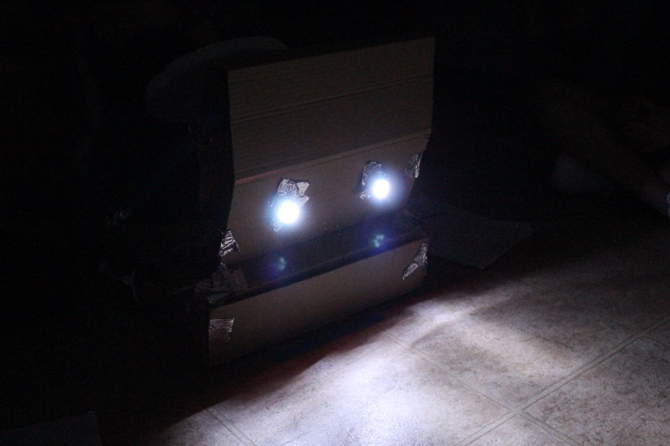
EXTENSION 2: BUILDING BETTER MODELS!
ELABORATE
TESTING AT NIGHT – Modify your test area.
Since you will be testing your signs for a car driving at night, you will need to modify your test area.
Notes:
Make sure the model cars are far enough away that light can travel to the sign with enough room to retroreflect back to eyes of the drivers. Remember there are large, tall trucks on the road carrying heavy loads.

Slide 35
ELABORATE
ELABORATE
STUDENT ACTIVITY:
Engineering Design Process Challenge
TEST AND EVALUATE DESIGN:
Test your sign to determine its retroreflectivity.
REDESIGN OR BUILD:
Based on the testing, think about ways to improve your sign.
SHARE SUCCESS:
Each team will present their team sign and ideas for improvement. As you watch others present, be sure to record the best features from their designs and concerns you may have.
Notes:
TEST YOUR DESIGN: Encourage the group to think about how they are going to evaluate each sign. What criteria will they use? If Extension 2 is not used, each team can simply stand at the same location, turn off the lights, hold a flashlight up, and analyze their results. You can use 2 flashlights to mimic headlights. Make sure the lights are in the same position for each presentation (height of the observer matters).
REDESIGN OR BUILD: Have the teams think about how they would redesign their sign to address some of the issues identified.
SHARE SUCCESS!! Have each team present their sign and highlight all the ideas behind each component and ways they could improve upon their design.

Slide 36
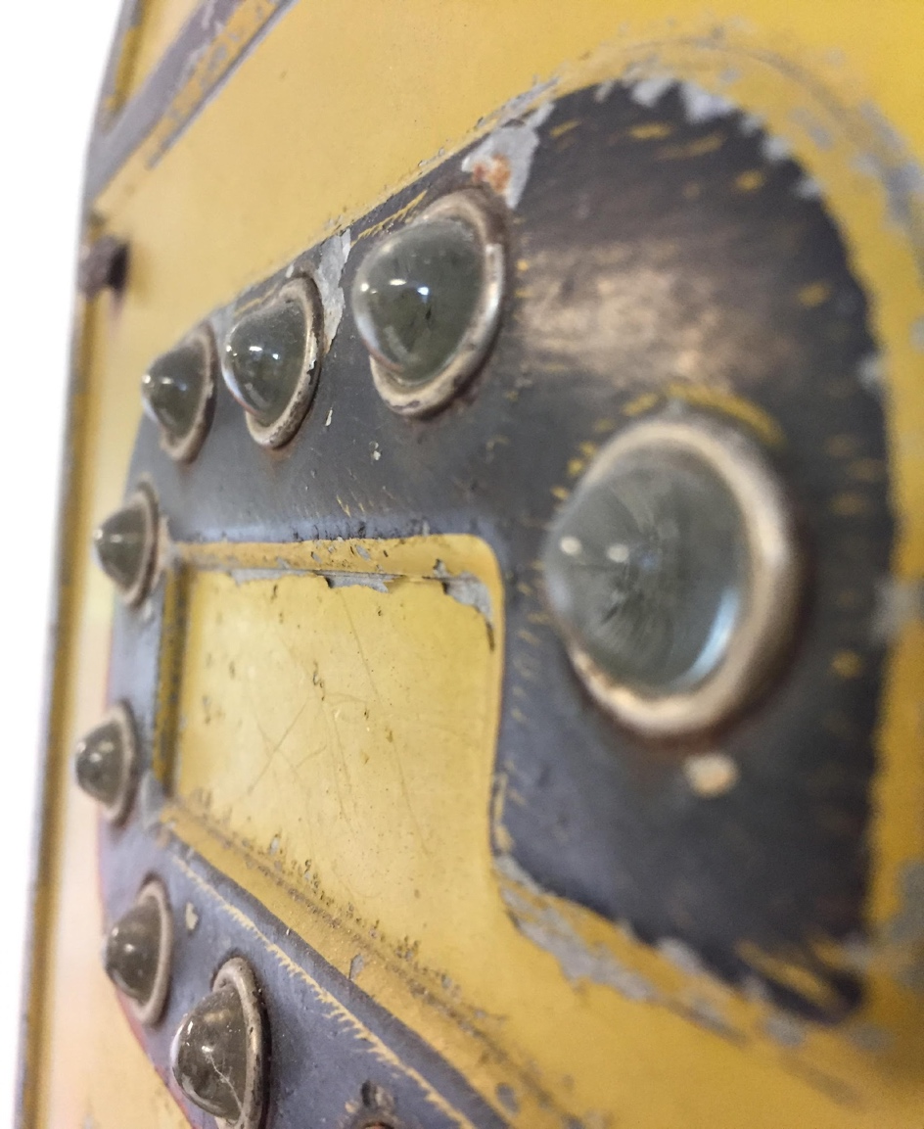
FUN FACTS IN TRANSPORTATION
ELABORATE
Glass spheres are among the most simple retroreflectors. With the right reflective surface behind or around them, they can bend and reflect light back to the source. As early as the 1920’s important signs were improved by adding large glass spheres to make them more visible.

Slide 37
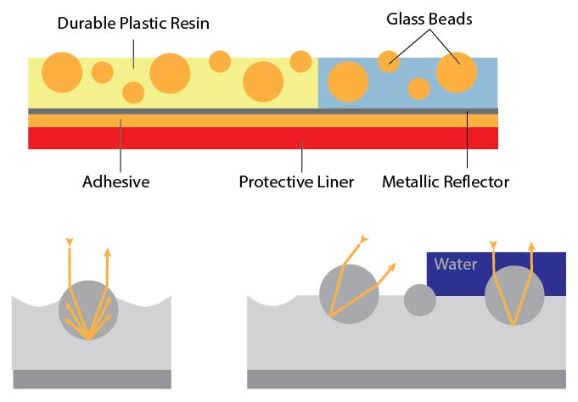
FUN FACTS IN TRANSPORTATION
ELABORATE
ELABORATE
Beginning in the 1940’s, tiny glass retroreflecting beads were added to nearly all signs, and greatly improved traffic safety.
Notes:
Exposed lens sheeting was the first type of sign sheeting to provide retroreflectivity. The problem with exposed lens sheeting is that when water was on the surface, the light is refracted in the wrong directions where the water meets the beads. This meant that it was not “retroreflective” when wet, such as during and following rain or in the morning when condensation is on the surface.

Slide 38
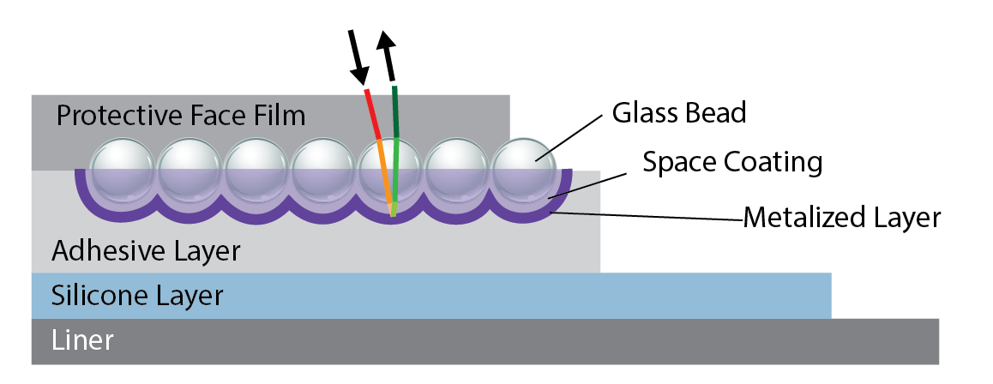
FUN FACTS IN TRANSPORTATION
ELABORATE
ELABORATE
Soon after, a protective film was added over the glass beads to combat dust and water that distorted the retroreflectivity of the beads. In addition, the metallized layer was moved closer to the individual beads to improve retroreflectivity.
Engineering Grade
Notes:
Enclosed lens sheeting embedded the glass beads in a transparent plastic, improving the retroreflection. Specular reflection occurring at metal coating. This material is commonly known as ENGINEERING GRADE sheeting.

Slide 39
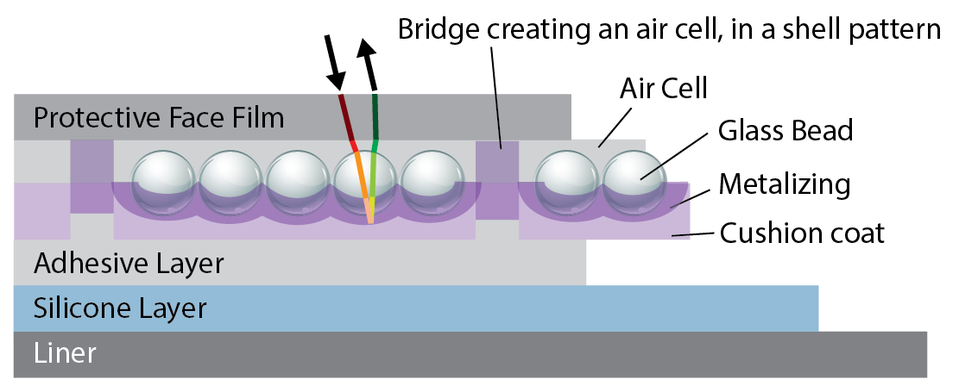
FUN FACTS IN TRANSPORTATION
ELABORATE
ELABORATE
In the 1970’s, the metal coating was added to the back of each bead making them three to four times brighter.
High Intensity
Notes:
The next development in sign sheeting was encapsulated lens sheeting. This sheeting has the beads completely under plastic, like enclosed lens sheeting, but actually has an air space on top of the bead. Other changes made to this sheeting is the use of a mirror coat right on the back of the bead instead of a distance behind the bead. All these changes made the sheeting more efficient at returning light. This material is commonly known as HIGH INTENSITY sheeting.

Slide 40
EVALUATE
40

Slide 41
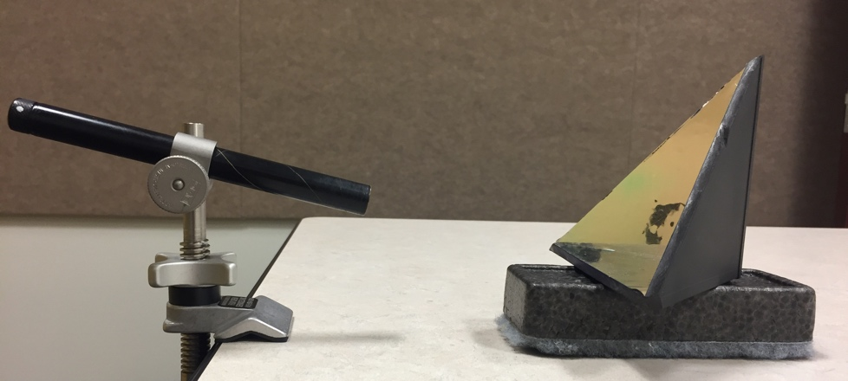
EVALUATE
TEACHER DEMONSTRATION: Prismatic Retroreflection
Some retroreflective materials contain thousands of cube corner retroreflectors in just a square inch of material.
This demonstration will help you understand how they work.
LIGHT FROM
TEACHER
CUBE CORNER
WHITE WALL/PAPER
Video link for further demonstration and explanation: https://www.youtube.com/watch?v=S4vYq31cpyc
Notes:
The teacher will show a brief video and/or conduct a demonstration using a laser pointer on a cube corner retroreflector to demonstrate how the prismatic retroreflectors work. This demonstration shows how light is reflected off multiple sides to reflect back towards the light source. You can also demonstrate the retroreflection of the bicycle reflector included in the kit by changing the angle of the flashlight.

Slide 42
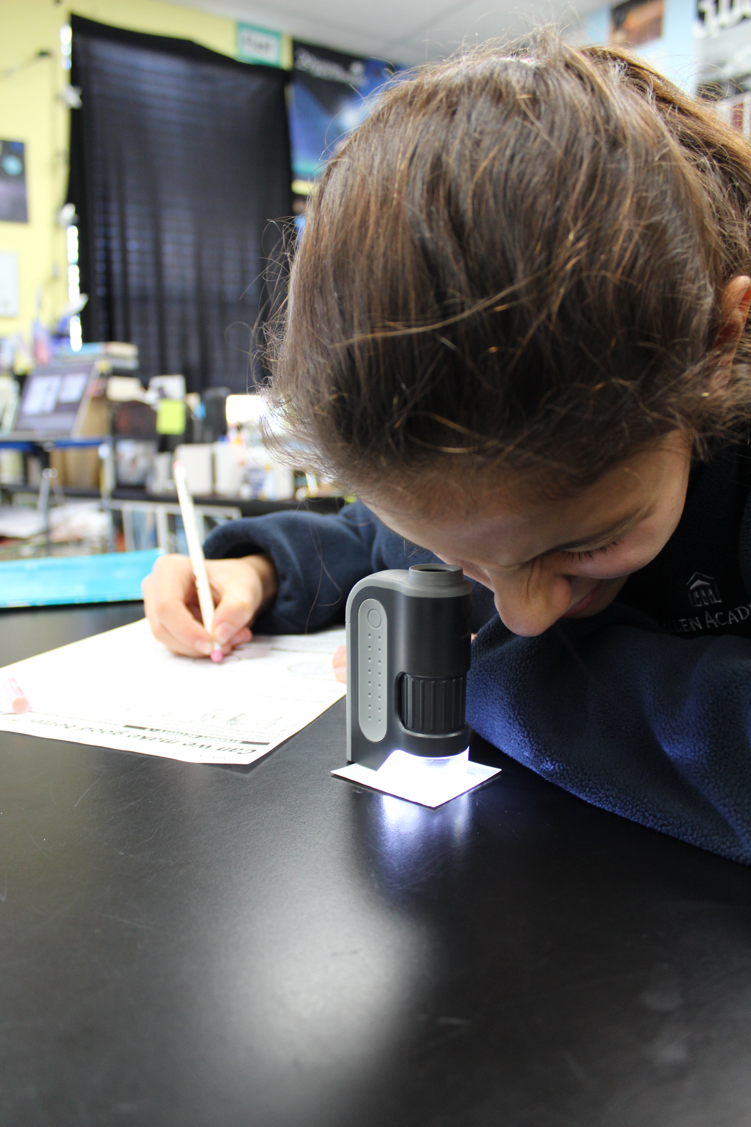
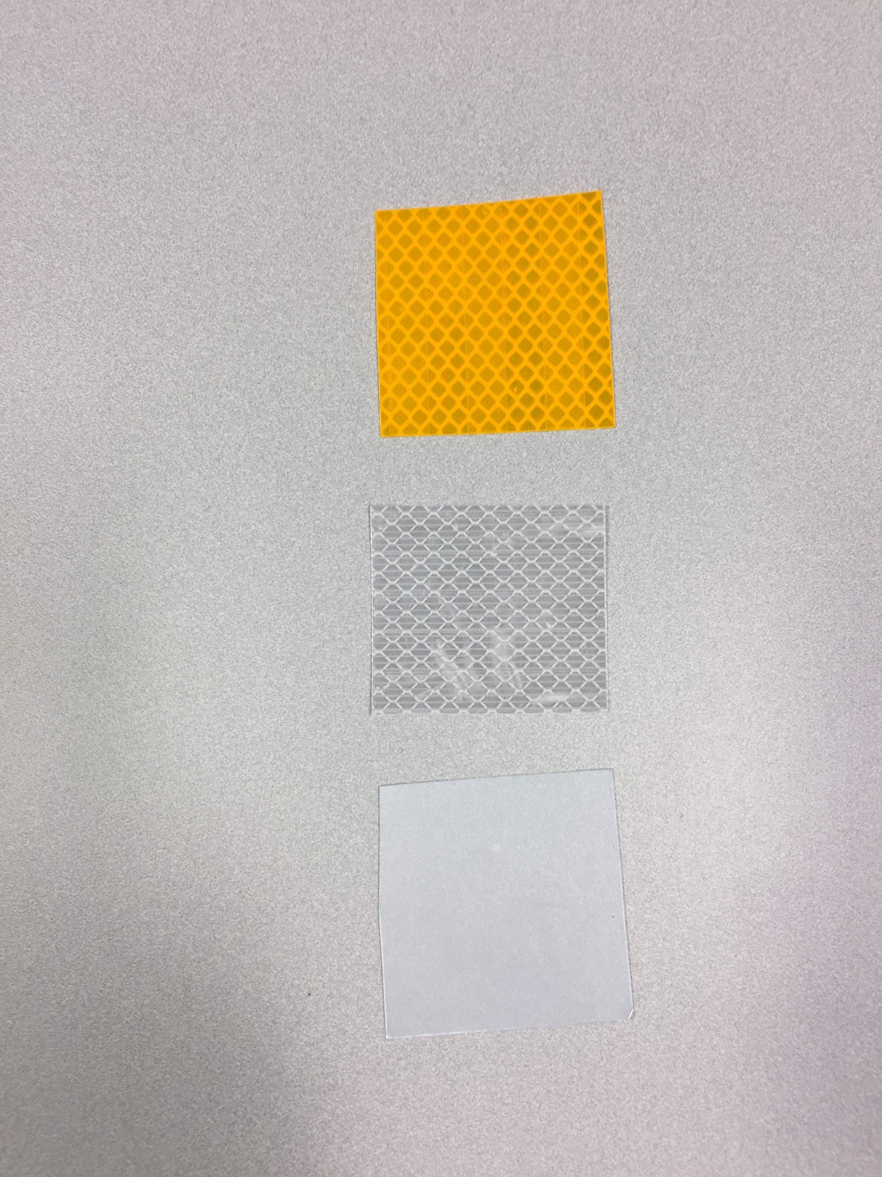
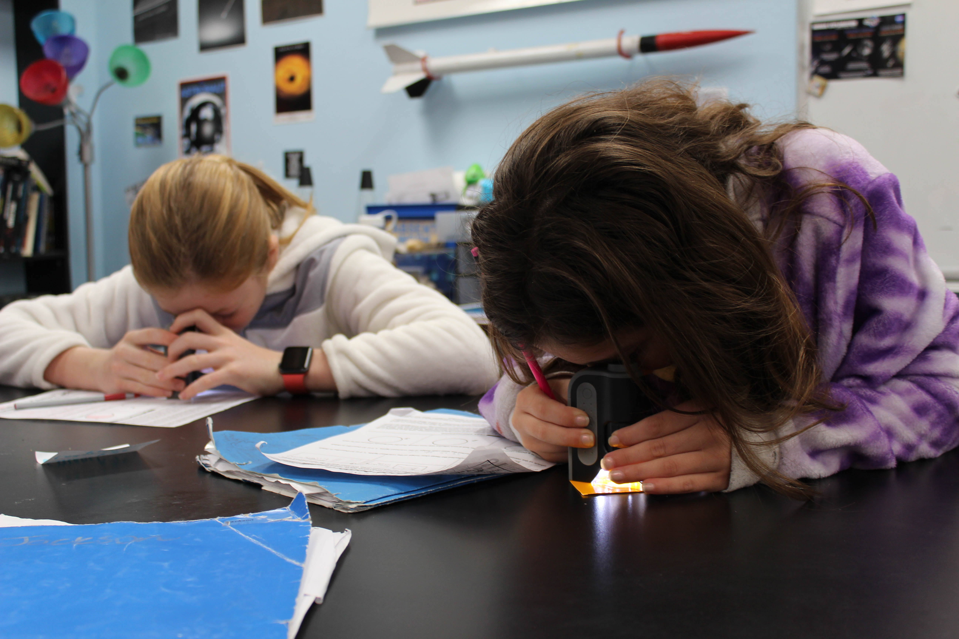
EVALUATE
STUDENT ACTIVITY: A CLOSER LOOK!
Now it is time for you to look at retroreflective sign sheeting up close!
1
2
3
Notes:
Provide each student group with numbered sign sheeting material (#1, #2, and #3) and a pocket microscope. The students will describe and illustrate what they see through the microscope for each piece of sign sheeting material.

Slide 43
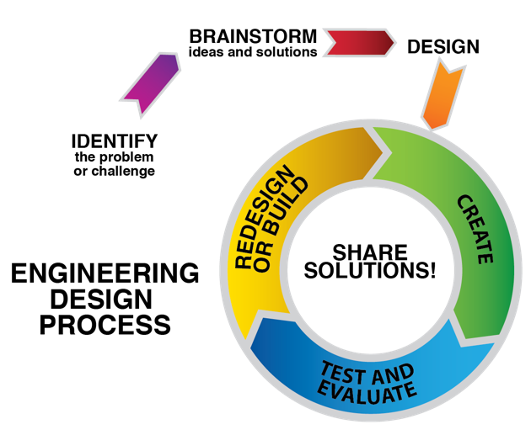
EVALUATE
STUDENT ACTIVITY: Test Engineering
You will now be a test engineer!
You will design your own method to test the retroreflectivity of each material (#1, #2 and #3).
You will analyze your findings and recommend the material with the best retroreflectivity for drivers at night!
Be sure that your investigation follows the engineering design process.
You will identify the problem or challenge.
Brainstorm ways to test retroreflectivity.
Create the test.
Conduct your investigation, analyze and share!
Notes:
In this activity students will be challenged to set up their own investigation in order to recommend the most effective retroreflective materials based on their data from the first two activities as well as information collected and analyzed in an investigation of their own. The emphasis on this activity is each group’s ability to design and carry out a relevant investigation. They will again follow the engineering design process to develop their investigation and will answer questions provided, as well as their own questions.
They will share their investigation with the class through a brief presentation, relaying the test they designed along with their findings, analysis and official recommendation for one of the retroreflective materials (1, 2 or 3).

Slide 44
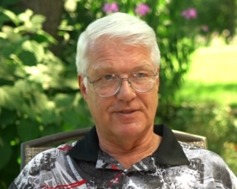
FUN FACTS IN TRANSPORTATION
EVALUATE
“How the power of perseverance helped lead to a road safety breakthrough”
A Story about 3M Engineer, Tim Hoopman
VIDEO LINK
“I have 37 patents.
One in a thousand succeeds, so I must have 37,000 failures…”
http://www.3m.com/3M/en_US/particles/all-articles/article-detail/~road-traffic-safety-reflective
-signs-visibility?storyid=2cb8314f-358f-4924-800e-cc2b75191237&wt.z_ch=fb&wt.z_cp=applied_to_life&wt.z_mt=photo&wt.mc_id=road+safety2077
Tim Hoopman
Notes:
The link will take you to the article written about Tim Hoopman, an inspiration on perseverance and engineering. The video is found on the actual webpage.

Slide 45
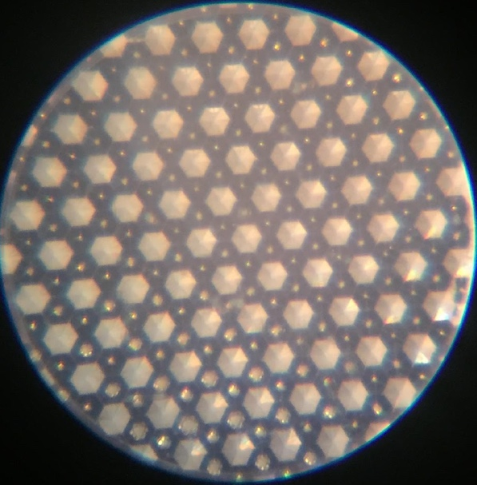
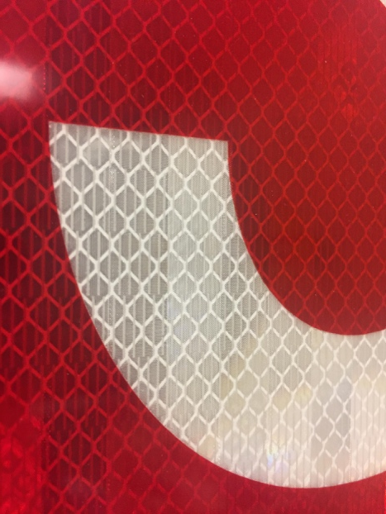
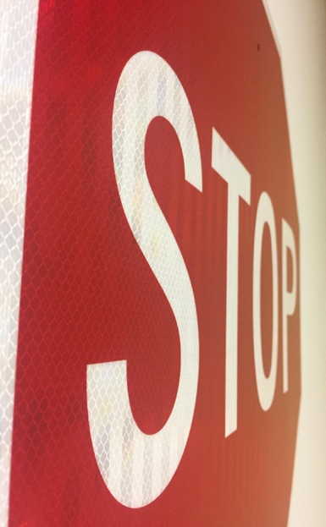
FUN FACTS IN TRANSPORTATION
EVALUATE
In the 1990s, microscopic prismatic sheeting became the latest solution to traffic safety with around 7,000 microprisms in every square inch.
Prismatic
Notes:
This material is known as prismatic sheeting.

Slide 46
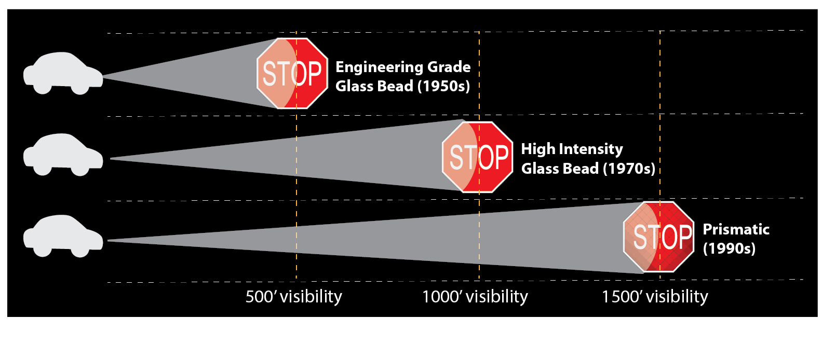
FUN FACTS IN TRANSPORTATION
EVALUATE
This graphic shows the visibility improvements between Engineering grade, High Intensity, and Prismatic sign sheeting materials.
Notes:
This graphic show the visibility improvements gained from engineering grade to high intensity to diamond (prismatic) sign sheeting.

Slide 47
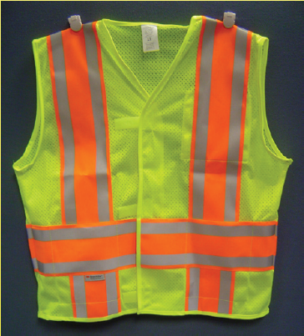
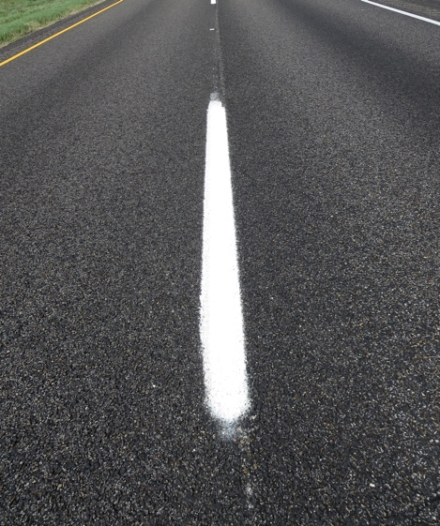
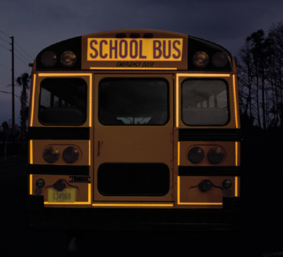
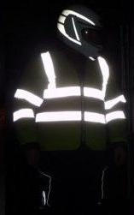
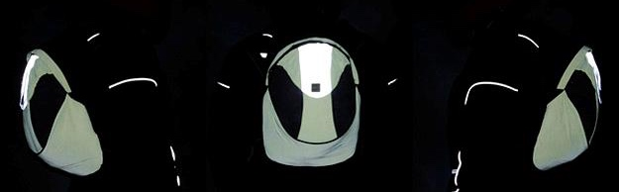
FUN FACTS IN TRANSPORTATION
EVALUATE
EVALUATE
Notes:
List other items that retroreflect (some are shown on slide)!
Construction worker vests (gray/silver material)
Backpacks (look for gray/silver material)
Clothing (look for gray/silver material)
Tennis shoes (look for gray/silver material)
School buses (conspicuity markings)
Commercial vehicles (conspicuity markings)
Train cars (conspicuity markings)
Pavement markings

Slide 48
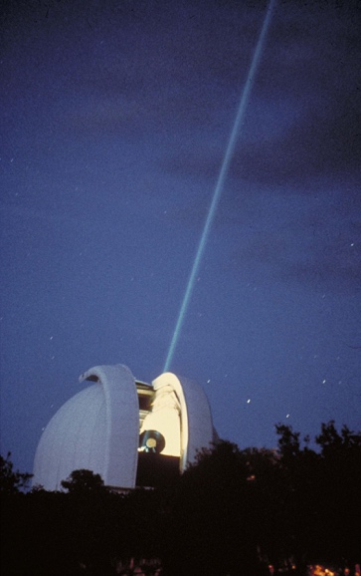
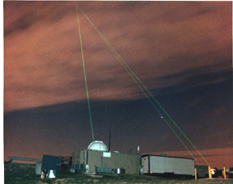
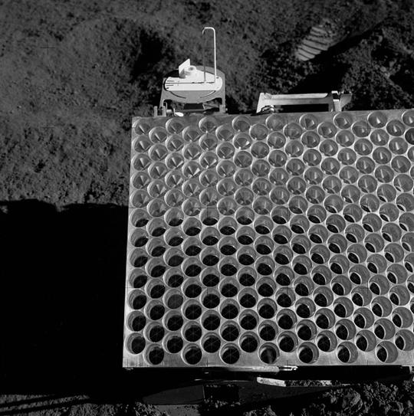
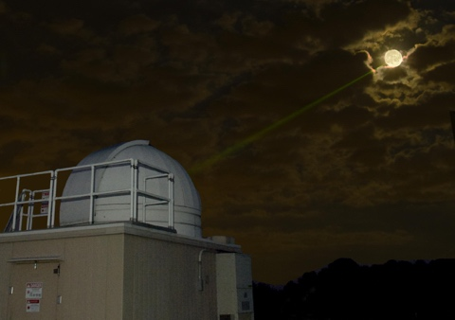
COOL FACT
EVALUATE
MYTHBUSTERS: MOON HOAX RETROREFLECTORS!
Video Link: https://www.youtube.com/watch?v=VmVxSFnjYCA
Goddard Space Flight Center. Credit: NASA.
McDonald Laser Ranging Station in West Texas, shines its laser light towards the moon’s retroreflectors. Credit: McDonald Observatory.
Credit: NASA’s Goddard Space Flight Center/Bill Hrybyk.
A portion of the Apollo 15 lunar laser ranging retroreflector array, as placed on the Moon and photographed by D. Scott.
Credit: NASA/D. Scott
Notes:
This extra video shows how we use retroreflectors on the moon and a laser to see how far away the moon is from Earth at any given time! One of the testing facilities is here in Texas!

Slide 49


EXTENSION 3: RETROREFLECTIVE CLASS SIGN!
EVALUATE
BUILD A RETROREFLECTIVE CLASS SIGN TO KEEP
Using materials found in the classroom and the consumable container in the TTI Retroreflection Kit, design and create a sign to hang up and keep in the classroom!
Notes:
Let’s put the A into STEM and move into STEAM! Using glass marbles or beads and/or prismatic materials from the consumable container of the activity kit, create a special retroreflective sign or keepsake for the classroom. Ideas include the school mascot, school initials, teacher’s name, school name, logos, motivational wording and more! Hang it up and enjoy!

Slide 50
50
Notes:
These slides are designed to be used as a supplement to the lessons for Exploring the Science of Retroreflectivity.

Slide 51


THANK YOU FOR CHOOSING TO TEACH RETROREFLECTION IN YOUR CLASSROOM!
We would like to hear from you! Please share your thoughts on how you used the lessons and photos of your students completing activities along with completed projects. We also welcome your experience in ways we can work to make the unit even better for teachers, students and facilitators.
Please send information and photos to
STEM@tti.tamu.edu.

